Slide 1
National symbols of GB
By Artem Fedchenko

Slide 2
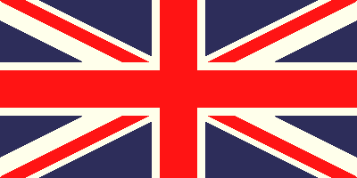
Union Jack
It’s a flag of Great Britain, It was called
“Union Jack”

Slide 3
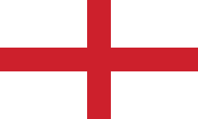
Flag of England
The flag of England is derived from St George's Cross. The association of the red cross as an emblem of England can be traced back to the Middle Ages, and it was used as a component in the design of the Union Flag in 1606. Since the 1990s it has been in increasingly wide use, particularly at national sporting events.

Slide 4
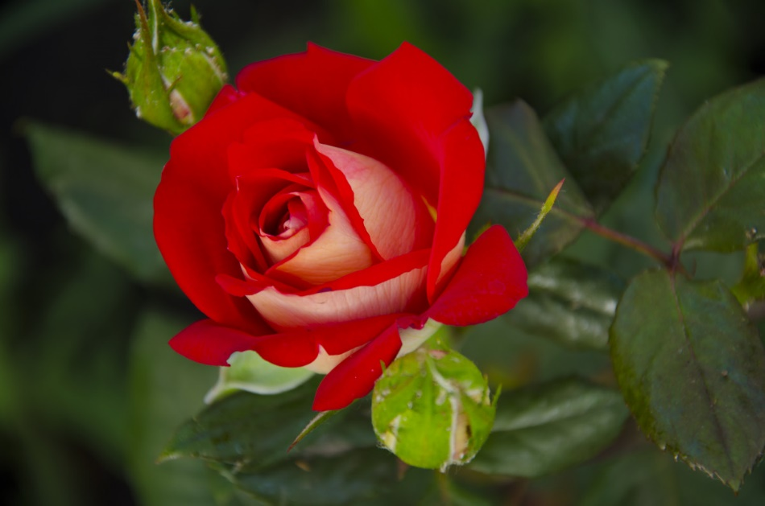
The Royal Banner of England
This banner is also known as the Banner of the Royal Arms, amongst its other names. It is the official English banner of arms and represents the sovereignty of the rulers of England (as opposed to loyalty to the country itself). It comprises three horizontally positioned gold lions, which face the observer. Each has a blue tongue and blue claws and is set against a deep red background.

Slide 5
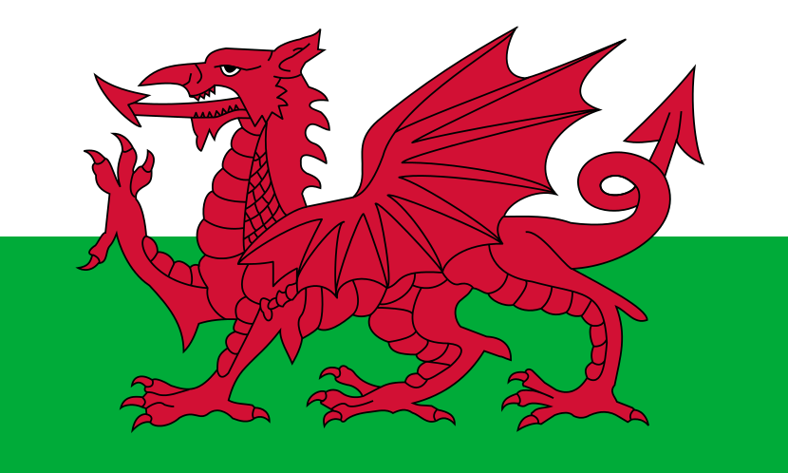
Flag of Wales
The flag of Wales(Welsh: Baner Cymru or Y Ddraig Goch, meaning "The Red Dragon") consists of a red dragon passant on a green and white field. As with many heraldic charges, the exact representation of the dragon is not standardised and many renderings exist.
The flag incorporates the Red Dragon of Cadwaladr, King of Gwynedd, along with the Tudor colours of green and white.

Slide 6
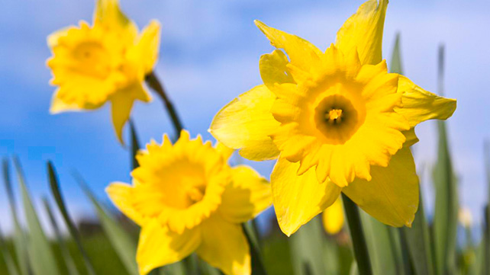
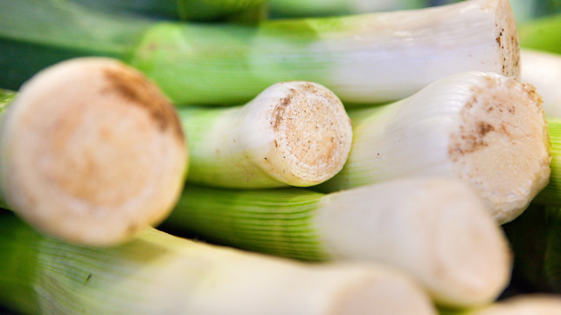
National symbols of Wales
This is one for those who believe that contemporary culture is all style over substance. The origins of the national flower of Wales appears to be as an attractive interloper, introduced during the 19th century, as a replacement for the humble leek

Slide 7
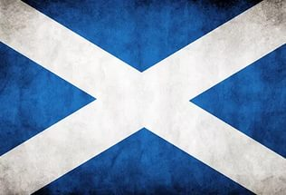
Flag of Scotland
The Flag of Scotland, also known as St Andrew's Cross or the Saltire, is the national flag of Scotland. As the national flag, the Saltire, rather than the Royal Standard of Scotland.

Slide 8
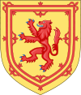
National symbols of Scotland
The Royal Arms of Scotland is a coat of arms symbolising Scotland and the Scottish monarchs.

Slide 9
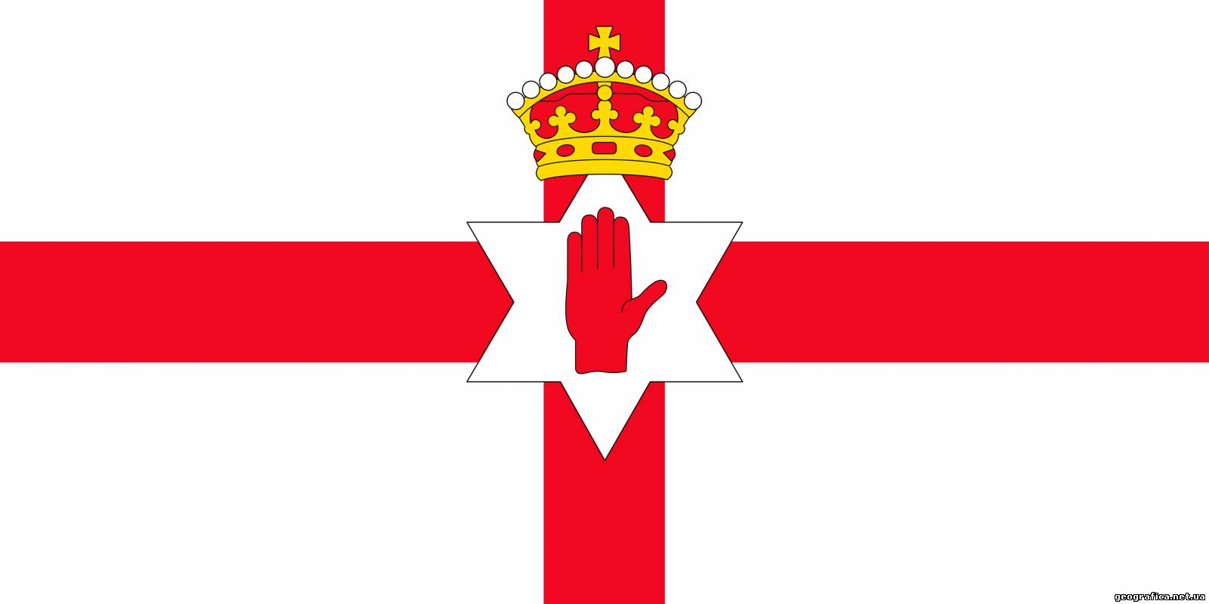
Flag of Northern Ireland
The Flag of Northern Ireland was used by the Northern Ireland parliament and government from 1953 until the parliament was abolished in 1973.

Slide 10
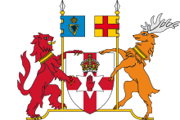
National symbols of Northern Ireland
The coat of arms of Northern Ireland was granted to the Government of Northern Ireland in 1924, and went out of official use in 1972 when that government was abolished.

Slide 11
Thanks foe your attention

