Slide 1
At the Doctor

Slide 2
Oh, my head! I have a headache,
Oh, my tooth! I have a toothache,
Oh, my stomach! I have a stomachache,
Oh, my back! I have a backache,
Oh, my ear! I have an earache,
Oh, my eyes! I have sore eyes,
Oh, my thumb! I have a sore thumb,
Oh, my throat! I have a sore throat.
Where is a doctor? I don’t know!

Slide 3


Slide 4
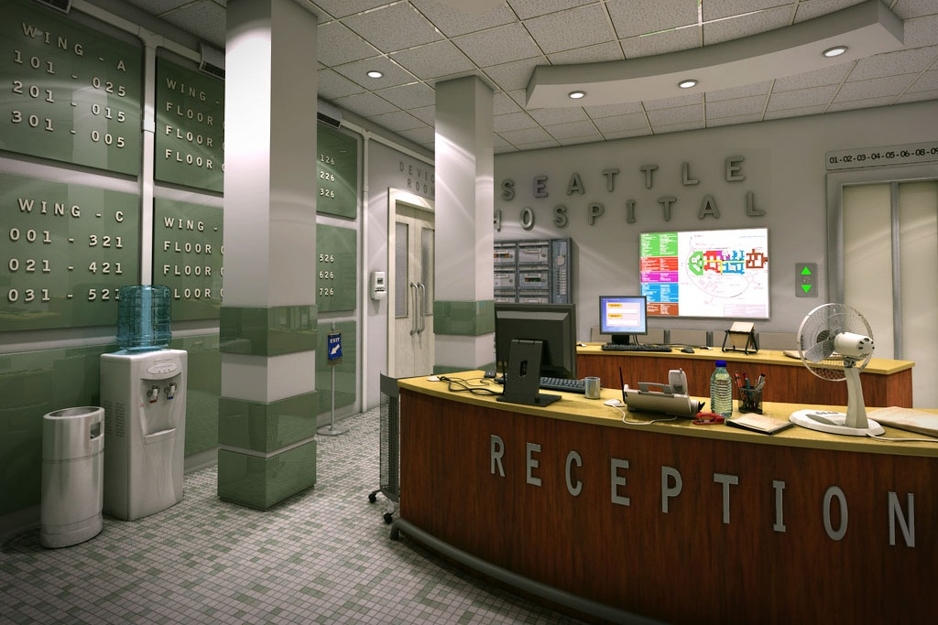
At the hospital

Slide 5
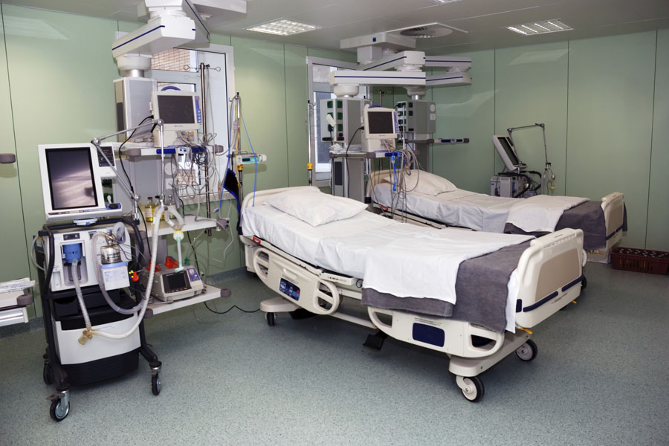
A ward: isolation ward, private ward.

Slide 6

Doctors, nurses, dentists.

Slide 7
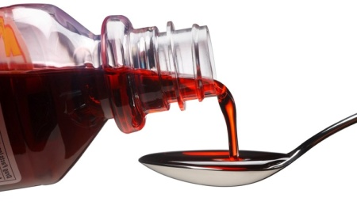

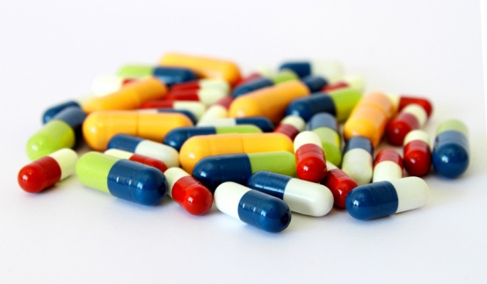
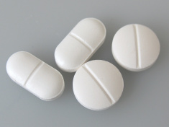
Types of medicines
syrup
herbal remedies
capsules
tablets

Slide 8
Task 1.
To be healthy you should or shouldn’t… Put in two columns
eat a light meal, eat too much ice cream, eat vegetables, eat fruits, wear warm clothes, walk in the rain, sunbathe a lot, smoke, drink alcohol, spend too much time in front of the TV, get enough sleep, get regular exercise.
You should: | You shouldn’t:

Slide 9
Doctor (D): Good morning.
Patient (P): Hello, Doctor.
D: Now then, how can I help you?
P: Well doctor, I've got a headache.
D: Do you have any other symptoms? A temperature, for example?
P: Well yes, I have high temperature, actually.
D: It looks to me as if you've got a cold.
P: Oh, have I, doctor?
D: Yes. Now I give you these pills. You should take two pills three times a day.
P: Thank you, doctor, thank you.

Slide 10
Task 2. Сделайте подобные диалоги, как в предыдущем слайде., меняя болезни и симптомы.Do the dialogues:
A headache – a cold A stomachache – some stomach infection A toothache – caries An earache – the flu A sore throat – a bad cold

Slide 11
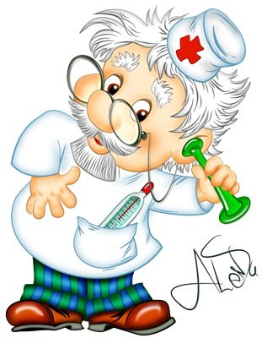
Good-bye!

